Slide 1




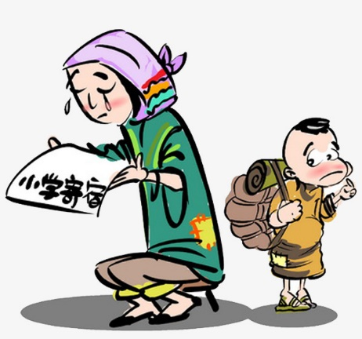
Community Members Roster
Event Reports & Statistics
Participants
Referrals
Advertisement
Memorandum of Agreement
Partner’s Profile
Event Schedules & Reports
Donors & Beneficiaries Roster
Advertisement
Departmental Information
Approvals
Event Schedules
Budget Plan
Company Information
Personal Information
Event Proposals &Sponsorships
Partner Referrals
Donations
Re-COP/Admin
Partners & Linkages
Community Profile
Event Schedules
Beneficiary Profile
Donations
Recoletos Community Outreach Program Community Extension Website
Organizational Information
Personal Information
Referrals
Participations & Evaluations
Donations
Beneficiary Information
Help Requests
Beneficiaries
SSCRdC Community

